Slide 1
PREDICTIVE MAINTENANCE FOR FAULT DETECTION IN INDUSTRY 4.0
By,
P Vamshi Krishna Reddy
Date: 23-05-2020
Department of Computer Science & Engineering

Slide 2
Table Of Contents
Abstract
Discussion about domain
Discussion about base paper
Literature survey
Existing system
Proposed system
Implementation
Results and discussions
CONCLUSION AND FUTURE WORKS
REFERENCES
Date: 23-05-2020
Department of Computer Science & Engineering

Slide 3
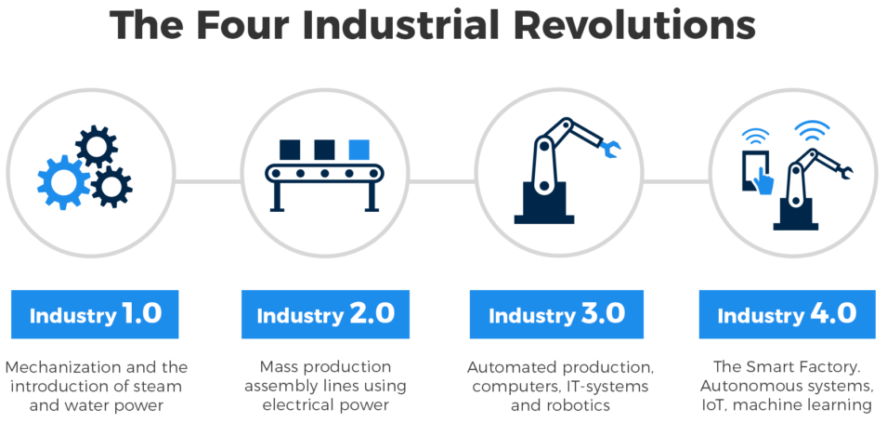
ABSTRACT
The area of predictive maintenance has taken a lot of prominence in the last couple of years due to various reasons. With new algorithms and methodologies growing across different learning methods, it has remained a challenge for industries to adopt which method is fit, robust and provide most accurate detection. Fault detection is one of the critical components of predictive maintenance; it is very much needed for industries to detect faults early and accurately. Predicting the life condition of a component is so crucial for industries that have intent to grow in a fast paced technological environment.
Date: 23-05-2020
Department of Computer Science & Engineering
Slide 01

Slide 4
Recent studies on predictive maintenance help industries to create an alert before the components are corrupted, reducing their maintenance cost. To predict and be ahead of all these scenarios we imply artificial intelligence (AI) and deep learning using long short-term memory (LSTM) neural networks to predict when an aircraft engine might require to be serviced or replaced. LSTM model deals with a sequential input data. Training process of LSTM networks has been performed on large-scale data processing engine with high performance. For these predictions we require a dataset of previous aircraft historical data of each aircraft. Aircrafts have three different settings that we can manipulate and find out the relation / trend in the data so that our system gets capable of predicting remaining useful life (RUL) of an aircraft engine.
Date: 23-05-2020
Department of Computer Science & Engineering
Slide 02

Slide 5
DISCUSSION ABOUT DOMAIN
Machine learning
Arthur Samuel described it as: “The field of study that gives computers the ability to learn without being explicitly programmed.”
Machine learning is an application of artificial intelligence (AI) that provides systems the ability to automatically learn and improve from experience without being explicitly programmed. Machine learning focuses on the development of computer programs that can access data and use it to learn for themselves.
The primary aim is to allow the computers learn automatically without human intervention or assistance and adjust actions accordingly. Machine learning algorithms build a mathematical model based on sample data, known as "training data", in order to make predictions or decisions without being explicitly programmed to do so. Machine learning algorithms are used in a wide variety of applications, such as email filtering and computer vision, where it is difficult or infeasible to develop conventional algorithms to perform the needed tasks. Machine learning is closely related to computational statistics, which focuses on making predictions using computers.
Date: 23-05-2020
Department of Computer Science & Engineering
Slide 03

Slide 6
Deep learning
Deep learning is a class of machine learning algorithm that uses multiple layers to progressively extract higher level features from the raw input. For example, in image processing, lower layers may identify edges, while higher layers may identify the concepts relevant to a human such as digits or letters or faces.
Most modern deep learning models are based on artificial neural networks, specifically, Convolutional Neural Networks (CNN)s, although they can also include propositional formulas or latent variables organized layer-wise in deep generative models such as the nodes in deep belief networks and deep Boltzmann machines.
Date: 23-05-2020
Department of Computer Science & Engineering
Slide 04

Slide 7
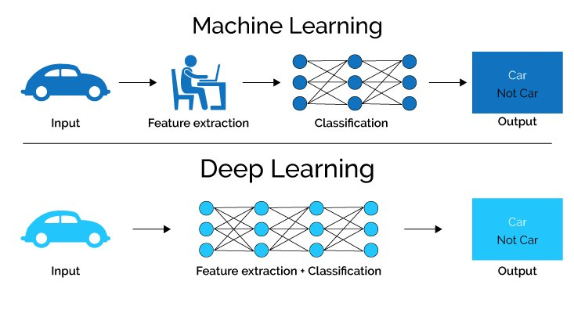
In deep learning, each level learns to transform its input data into a slightly more abstract and composite representation. In an image recognition application, the raw input may be a matrix of pixels; the first representational layer may abstract the pixels and encode edges; the second layer may compose and encode arrangements of edges; the third layer may encode a nose and eyes; and the fourth layer may recognize that the image contains a face. Importantly, a deep learning process can learn which features to optimally place in which level on its own.
Date: 23-05-2020
Department of Computer Science & Engineering
Slide 05

Slide 8
Recurrent Neural Networks
Humans don’t start their thinking from scratch every second. As you read this essay, you understand each word based on your understanding of previous words. You don’t throw everything away and start thinking from scratch again. Your thoughts have persistence.
Traditional neural networks can’t do this, and it seems like a major shortcoming. For example, imagine you want to classify what kind of event is happening at every point in a movie. It’s unclear how a traditional neural network could use its reasoning about previous events in the film to inform later ones.
Recurrent neural networks address this issue. They are networks with loops in them, allowing inform
Date: 23-05-2020
Department of Computer Science & Engineering
Slide 06

Slide 9
DISCUSSION ABOUT BASE PAPER
During the past decades aircraft engine were been developed with minimum number sensors as there was no requirement of various other sensor value which significance the engine condition of an aircraft. Now having all the new 21 sensor embedded inside an engine of an aircraft makes us to do predictive maintenance so that we save a lot of time and energy to avoid the necessity of doing unnecessary maintenance service. These sensors fitted the aircraft engine provide huge amount of previous data that actually shows the real condition of the engine.
These huge amounts of data may be stored in hard disk of aircraft engine or on the servers located in closed making it easier to locate and work with it whenever it is required.
Date: 23-05-2020
Department of Computer Science & Engineering
Slide 07

Slide 10
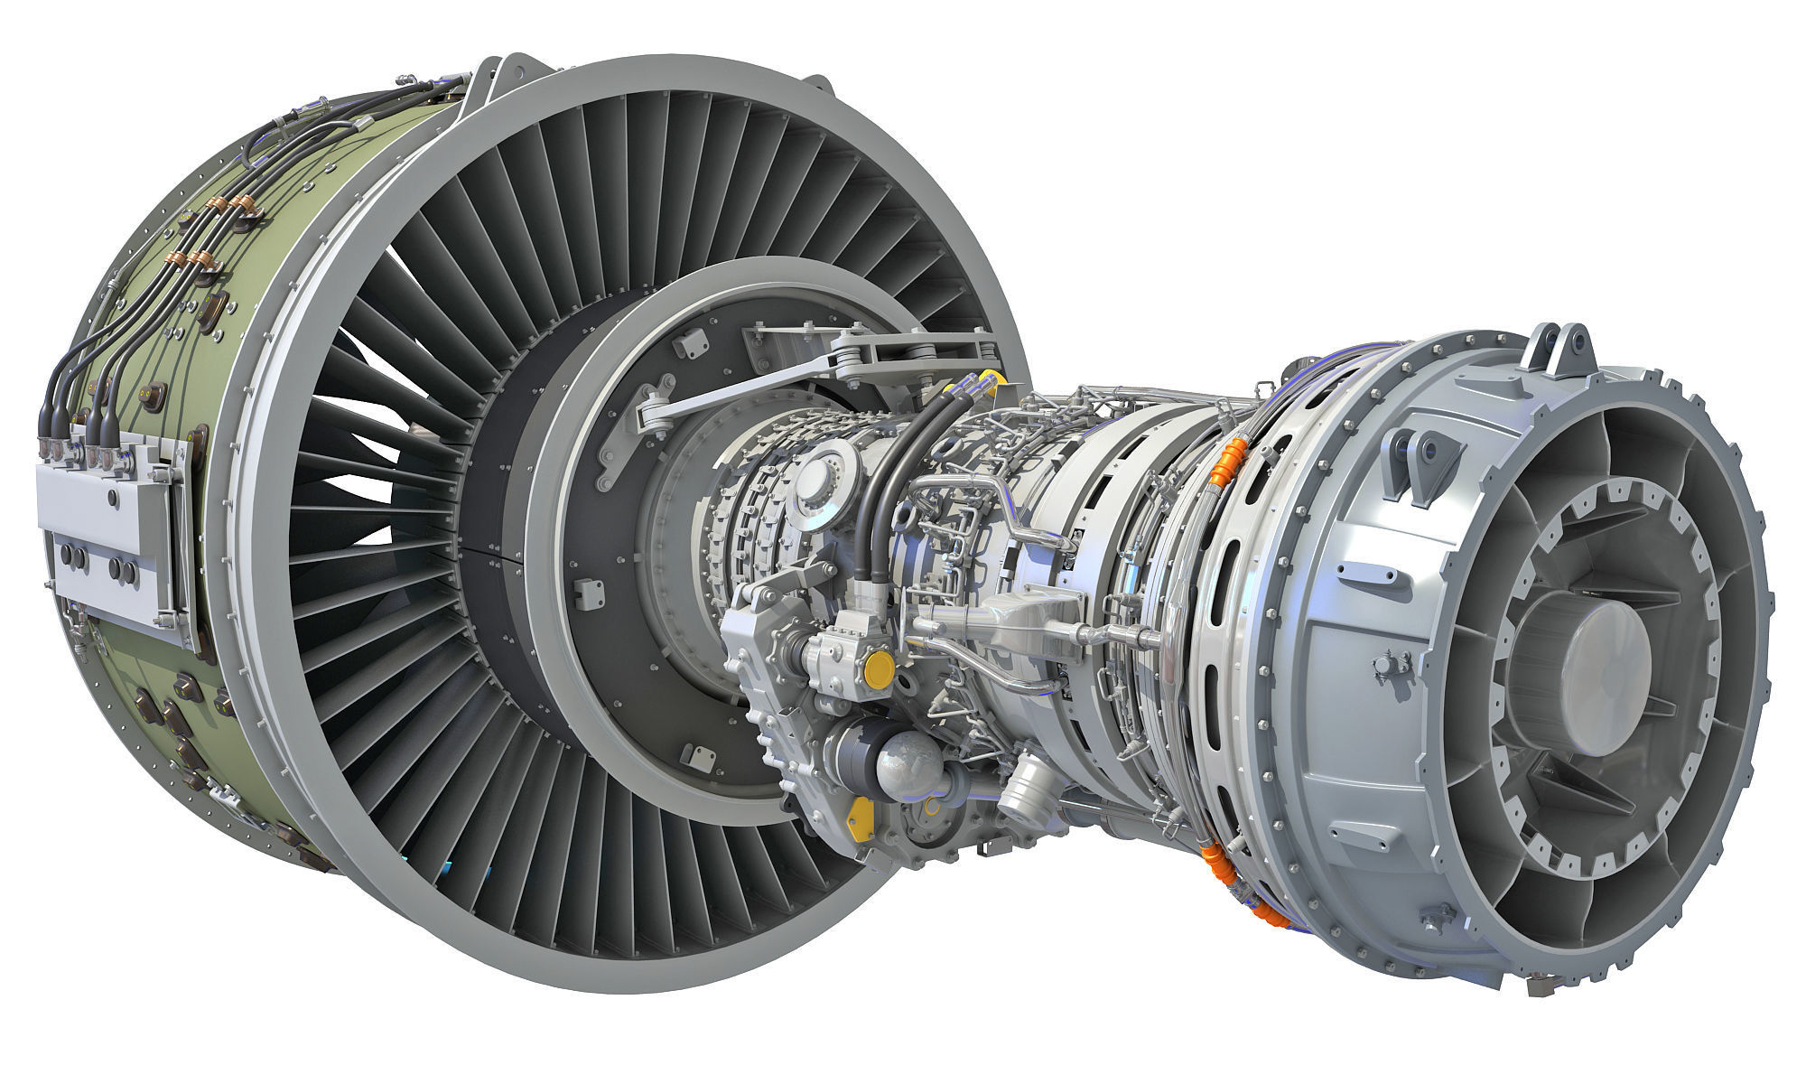
Hence by reducing the manual time to go work with the engines, so the maintenance service can be placed locally and can manipulate with the data stored in the closed and do predictive maintenance as and when required.
The deep learning approach of implementing Recurrent neural networks (RNN) and using long short term memory (LSTM) technique makes us predict the data set with time stamps which means the present data looks fifty time stamps in the past to predict the current remaining useful life (RUL) of the Aircraft engine and hence making it to be very accurate.
Figure of a turbofan Engine
Date: 23-05-2020
Department of Computer Science & Engineering
Slide 08

Slide 11
LITERATURE SURVEY
The primary goal of predictive maintenance is to reduce the cost of a product or service and to have a competitive advantage in the market to survive. Today business analytics are embedded across predictive maintenance to realize the need for it and to make appropriate decisions. Business analytics can be viewed in three different prospectives
Descriptive analytics
Predictive analytics and
Prescriptive analytics
Date: 23-05-2020
Department of Computer Science & Engineering
Slide 09

Slide 12
Descriptive analytics is a process of answering questions like what happened in the past? This is done by analysing historical data and summarizing them in charts. In maintenance, this step is performed using control charts.
Predictive analytics is an extension to descriptive analytics where historical data is analysed to predict the future outcomes. In maintenance, it is used predict type of failure and time to complete failure.
Prescriptive analytics is a process of optimization to identify the best alternatives to minimize or maximize the objective. This also answers the questions such as what can be done? In maintenance, this can be used to optimize the maintenance schedules to minimize the cost of maintenance.
Date: 23-05-2020
Department of Computer Science & Engineering
Slide 10

Slide 13
In this project, our primary focus will be on descriptive and predictive analytics to detect the faults. Predictive analytics has spread its applications into various applications such as railway track maintenance, vehicle monitoring, automotive subcomponents, utility systems, computer systems, electrical grids, aircraft maintenance, oil and gas industry, computational finance and many more. Fault detection is one of the concepts in predictive maintenance which is well accepted in the industry. Early Failure detection could potentially eliminate catastrophic machine failures.
Date: 23-05-2020
Department of Computer Science & Engineering
Slide 11

Slide 14
EXISTING SYSTEM
In the past years prediction done using machine learning approach which self learns the data implying different algorithm of supervised learning. In supervised learning data set includes the input variable (sensor values) which is then divided into train and test set using which RUL was predicted. The machine learning algorithm is trained using training set and the accuracy of the algorithm is tested by comparing it with the test set.
To overcome the drawback of low accuracy and less dependability of machine learning algorithm we use deep learning approach to solve this situation.
Date: 23-05-2020
Department of Computer Science & Engineering
Slide 12

Slide 15
PROPOSED SYSTEM
In this proposed techniques we implemented LSTM neural networks to improve the performance of our application. This LSTM techniques implies time stamps(steps) to look on to the past data and prepare our data set such that each row holds 50 values references to the original data sets. The LSTM neural network diagram for proposed system is shown in the figure
LSTM neural network diagram for proposed system
Date: 23-05-2020
Department of Computer Science & Engineering
Slide 13

Slide 16
1. INPUT DATA
A data set as been downloaded from Repository of NASA which as 21 individual sensor value and three setting values setting1, setting2, setting3 which shows below
Setting 1- This is the pilot1 prefers setting which shows the sensors which were activated during the life time of sensor.
Setting 2- This is the pilot2 prefers setting which shows the sensors which were activated during the life time of sensor.
Setting 3- This is the pilot3 prefers setting which shows the sensors which were activated during the life time of sensor.
Date: 23-05-2020
Department of Computer Science & Engineering
Slide 14

Slide 17
2. DATA PRE-PROCESSING
One of the important challenges of giving input data set to neural networks is data Pre-processing where you manipulate with the data and remove different unused values, redundant values, null values which can be drawback in forming of accurate predict value of the model.
Steps included in Data Pre-processing are listed below
We delete the null values
We scale down the data using Scikit-Learn library so that neural networks understand the data.(The scaling is done using Min-Max scaler library which scales down data between 0 and 1and hence making this data set completely comparable with the neural networks.)
Date: 23-05-2020
Department of Computer Science & Engineering
Slide 15

Slide 18
3. CONVERTING A DATA TO 50 TIME STAMPS
LSTM model understand data in user defined time step, the size of the time step in choosing based on the preferences of the problem. Here we use 50 time stamps.
4. TRAINING AND TESTING
We build a deep network. The first layer is an LSTM layer with 100 units followed by another LSTM layer with 50 units. Dropout is also applied after each LSTM layer to control overfitting. Final layer is a Dense output layer with single unit.
5. OUTPUT
Accuracy is calculated based on Mean Absolute Error (MAE) and Rsquared (R^2) error. MAE is a measured as the average sum of absolute difference between predicted and actual observation and R-squared is a statistical measure of how close the data are to the fitted regression line.
Date: 23-05-2020
Department of Computer Science & Engineering
Slide 16

Slide 19
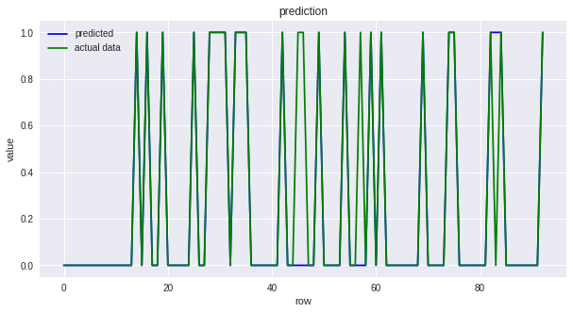
The Proposed RUL prediction Flowchart for the Machine Learning model
Graph which shows the difference between the predicted values and the actual data.
Date: 23-05-2020
Department of Computer Science & Engineering
Slide 17

Slide 20
IMPLEMENTATION
Keras has multiple implementations (the original keras implementation and the implementation native to tensorflow) and supports multiple backends ("tensorflow", "cntk", "theano", and "plaidml").
These functions allow switching between the various implementations and backends.
The functions should be called after library(keras) and before calling other functions within the package (see below for an example).
The default implementation and backend should be suitable for most use cases. The "tensorflow" implementation is useful when using keras in conjunction with tensorflow estimators (the tfestimators R package).
Date: 23-05-2020
Department of Computer Science & Engineering
Slide 18

Slide 21
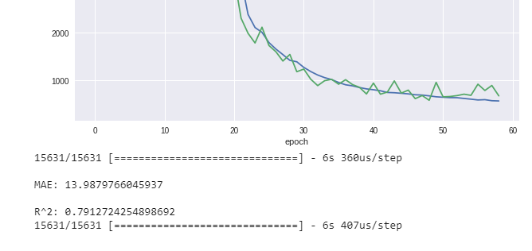
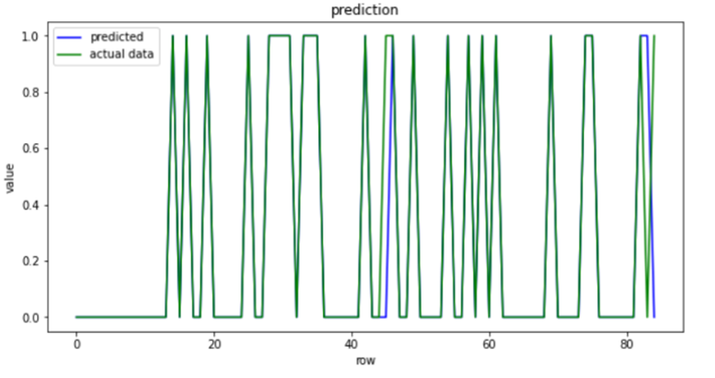
RESULTS AND DISCUSSION
By implying LSTM technique, we were able to get 96% accuracy making one application to be best reliable in predicting RUL of aircraft engine and hence by making passenger life safer and predictive maintenance much easier. The figure shows the MAE loss, R^2 loss and accuracy of the proposed method.
MAE loss, R^2 error loss of the proposed method
Predicted data vs Actual data
Date: 23-05-2020
Department of Computer Science & Engineering
Slide 19

Slide 22
CONCLUSION AND FUTURE WORK
Our proposed LSTM neural networks-based approach out performs and gets a lower MAE and R^2 value, indicating that the RUL predicted by the LSTM neural networks model for this set of data sets is very close to the actual value. The experimental results clearly show that the proposed method can accurately predict the RUL of aircraft engines.
Moreover, we can conclude that the prediction method based on LSTM neural networks is better than the traditional statistical probability regression method under the large amount of data. It is also concluded that RUL estimation of a unit with short history tends to produce great uncertainty which leads to inaccurate prediction. Hence, updating the RUL prediction is the key for effective planning. To further explore the new neural network architecture, to solve the PHM field of data prediction.
Date: 23-05-2020
Department of Computer Science & Engineering
Slide 20

Slide 23
REFERENCES
[1] Mobley, R Keith, “An Introduction to predictive maintenance”, 2002, 2nd ed, ISBN 0-7506-7531-4
[2] Groba. C, Cech. S, Rosenthal. F., Gossling. A, “Architecture of the predictive maintenance framework”, 6th International Conference on Computer Information Systems and Industrial Management Applications, 2007, IEEE
[3] M. Yuan, Y. Wu and L. Lin, "Fault diagnosis and remaining useful life estimation of aero engine using LSTM neural network," 2016 IEEE International Conference on Aircraft Utility Systems (AUS), Beijing, 2016, pp. 135-140, doi: 10.1109/AUS.2016.7748035.
[4] D. Bruneo and F. De Vita, "On the Use of LSTM Networks for Predictive Maintenance in Smart Industries," 2019 IEEE International Conference on Smart Computing (SMARTCOMP), Washington, DC, USA, 2019, pp. 241-248, doi: 10.1109/SMARTCOMP.2019.00059.
[5] Likhitha and Dr. R. Nagaraja. “Prediction of Remaining Useful Life of an Aircraft Engine Using LSTM Network.” (2019).
[6] Ahmed, M., Baqqar, M., Gu, F., Ball, A.D., 2012. “Fault detection and diagnosis using principal component analysis of vibration data from a reciprocating compressor”, in: Proceedings of the UKACC International Conference on Control, 3-5 September 2012, IEEE Press.
[7] E. Nardo, “Distributed implementation of a LSTM on Spark and Tensorflow”, 2016
[8] Q Zhou, J Son, S Zhou, X Mao, M Salman, Remaining “Useful life prediction of individual units subject to hard failure”, IIE Transactions Vol 46, Jun2014, pp. 1017-1030,doi:10.1080/0740817X.2013.876126
[9] A. Jardine, D. Lin, D. Banjevic. “A review on machinery diagnostics and prognostics implementing condition-based maintenance”, Mechanical Systems and Signal Processing, vol 20, Oct 2006, pp. 1483-1510, doi: 10.1016/j.ymssp.2005.09.012
[10] A. Jain, P. Kundu, B. K. Lad, “Prediction of remaining useful life of an aircraft engine under unknown initial wear minutes”, 5th International & 26th All India Manufacturing Technology, Design and Research Conference (AIMTDR 2014), Dec 2014, pp. 494:1- 494:5, doi: 10.1007/978-81-322-2352-8
[11] A. K. Mahamad, S. Saon, T.. Hiyama. "Predicting remaining useful life of rotating machinery based artificial neural network." Computers & Mathematics with Applications, vol.60, pp. 1078-1087, 2015
[12] Keras: Deep Learning library for Theano and TensorFlow, https://keras.io/
[13] Elephas: Distributed Deep Learning with Keras & Spark, https://github.com/maxpumperla/elephas
[14] D. Dong, X. Li and F. Sun, "Life prediction of jet engines based on LSTM-recurrent neural networks," 2017 Prognostics and System Health Management Conference (PHM-Harbin), Harbin, 2017, pp. 1-6, doi: 10.1109/PHM.2017.8079264.
Date: 23-05-2020
Department of Computer Science & Engineering
Slide 21

Slide 24
THANK YOU
Date: 23-05-2020
Department of Computer Science & Engineering
Slide 22

